Slide 1
Exception Handling
An exception is an abnormal condition that arises in a code sequence at run time
Java’s exception handling avoids the problems of handling errors manually and brings run-time error management into the object-oriented world.

Slide 2
Exception-Handling Fundamentals
A Java exception is an object that describes an exceptional (that is, error) condition that has occurred in a piece of code.
When an exceptional condition arises, an object representing that exception is created and thrown in the method that caused the error.
Exceptions can be generated by the Java run-time system, or they can be manually generated by your code.
Exceptions thrown by Java relate to fundamental errors that violate the rules of the Java language or the constraints of the Java execution environment.
Manually generated exceptions are typically used to report some error condition to the caller of a method.

Slide 3
Exception-Handling Fundamentals
Java exception handling is managed via five keywords: try, catch, throw, throws, and finally.
Program statements that you want to monitor for exceptions are contained within a try block.
If an exception occurs within the try block, it is thrown. Your code can catch this exception (using catch) and handle it in some rational manner.

Slide 4
System-generated exceptions are automatically thrown by the Java run-time system.
To manually throw an exception, use the keyword throw.
Any exception that is thrown out of a method must be specified as such by a throws clause.
Any code that absolutely must be executed after a try block completes is put in a finally block.

Slide 5
This is the general form of an exception-handling block:
try {
// block of code to monitor for errors
}
catch (ExceptionType1 exOb) {
// exception handler for ExceptionType1
}
catch (ExceptionType2 exOb) {
// exception handler for ExceptionType2
}
// ...
finally {
// block of code to be executed after try block ends
}

Slide 6
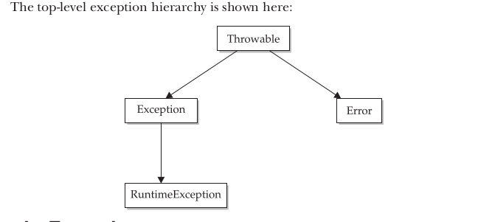
Exception Types

Slide 7
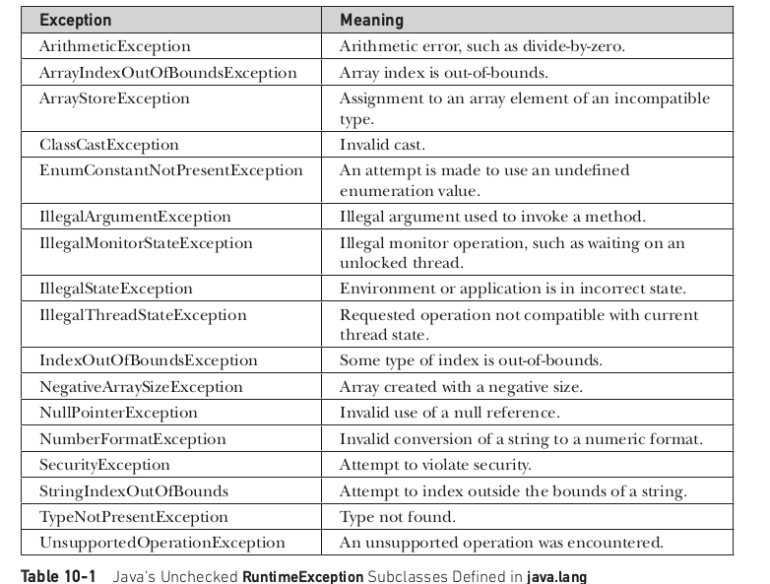
Exceptions in Java.lang

Slide 8
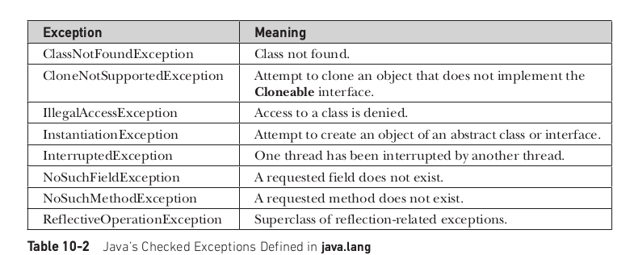

Slide 9
Uncaught Exceptions
class Exc0 {
public static void main(String args[]) {
int d = 0;
int a = 42 / d;
}
}
java.lang.ArithmeticException: / by zero
at Exc0.main(Exc0.java:4)

Slide 10
When the Java run-time system detects the attempt to divide by zero, it constructs a new exception object and then throws this exception.
This causes the execution of Exc0 to stop, because once an exception has been thrown, it must be caught by an exception handler and dealt with immediately.
If exception handler is not given, the exception is caught by the default handler provided by the Java run-time system.
The default handler displays a string describing the exception, prints a stack trace from the point at which the exception occurred, and terminates the program.

Slide 11
class Exc1 {
static void subroutine() {
int d = 0;
int a = 10 / d;
}
public static void main(String args[]) {
Exc1.subroutine();
}
}
java.lang.ArithmeticException: / by zero
at Exc1.subroutine(Exc1.java:4)
at Exc1.main(Exc1.java:7)

Slide 12
Using try and catch
Handling exception in our program allows to fix the error.
it prevents the program from automatically terminating
To guard against and handle a run-time error, simply enclose the code that you want to monitor inside a try block.
Immediately following the try block, include a catch clause that specifies the exception type that you wish to catch.

Slide 13
class Exc2 {
public static void main(String args[]) {
int d, a;
try { // monitor a block of code.
d = 0;
a = 42 / d;
System.out.println("This will not be printed.");
} catch (ArithmeticException e) { // catch divide-by-zero error
System.out.println("Division by zero.");
}
System.out.println("After catch statement.");
}
}
Output
Division by zero.
After catch statement.

Slide 14
The goal of most well-constructed catch clauses should be to resolve the exceptional condition and then continue on as if the error had never happened.

Slide 15
import java.util.Random;
class HandleError {
public static void main(String args[]) {
int a=0, b=0, c=0;
Random r = new Random();
for(int i=0; i<32000; i++) {
try {
b = r.nextInt();
c = r.nextInt();
a = 12345 / (b/c);
} catch (ArithmeticException e) {
System.out.println("Division by zero.");
a = 0; // set a to zero and continue
}
System.out.println("a: " + a);
}}}

Slide 16
Displaying a Description of an Exception
Throwable overrides the toString( ) method (defined by Object) so that it returns a string containing a description of the exception.
You can display this description in a println( ) statement by simply passing the exception as an argument.
catch (ArithmeticException e) {
System.out.println("Exception: " + e);
a = 0; // set a to zero and continue
}
Displays: Exception: java.lang.ArithmeticException: / by zero

Slide 17
Multiple catch Clauses
If more than one exception could be raised by a single piece of code,we can specify two or more catch clauses, each catching a different type of exception.
When an exception is thrown, each catch statement is inspected in order, and the first one whose type matches that of the exception is executed.
After one catch statement executes, the others are bypassed, and execution continues after the try / catch block.

Slide 18
class MultipleCatches {
public static void main(String args[]) {
try {
int a = args.length;
System.out.println("a = " + a);
int b = 42 / a;
int c[] = { 1 };
c[42] = 99;
} catch(ArithmeticException e) {
System.out.println("Divide by 0: " + e);
} catch(ArrayIndexOutOfBoundsException e) {
System.out.println("Array index oob: " + e);
}
System.out.println("After try/catch blocks.");
}}

Slide 19
C:\>java MultipleCatches
a = 0
Divide by 0: java.lang.ArithmeticException: / by zero
After try/catch blocks.
C:\>java MultipleCatches TestArg
a = 1
Array index oob: java.lang.ArrayIndexOutOfBoundsException:42
After try/catch blocks.

Slide 20
When you use multiple catch statements, it is important to remember that exception subclasses must come before any of their superclasses.
This is because a catch statement that uses a superclass will catch exceptions of that type plus any of its subclasses.
Thus, a subclass would never be reached if it came after its superclass. Further, in Java, unreachable code is an error

Slide 21
class SuperSubCatch {
public static void main(String args[]) {
try {
int a = 0;
int b = 42 / a;
} catch(Exception e) {
System.out.println("Generic Exception catch.");
}
/* This catch is never reached because
ArithmeticException is a subclass of Exception. */
catch(ArithmeticException e) { // ERROR – unreachable
System.out.println("This is never reached.");
}}}

Slide 22
Nested try Statements
The try statement can be nested.
Each time a try statement is entered, the context of that exception is pushed on the stack.
If an inner try statement does not have a catch handler for a particular exception, the stack is unwound and the next try statement’s catch handlers are inspected for a match.
This continues until one of the catch statements succeeds, or until all of the nested try statements are exhausted.
If no catch statement matches, then the Java run-time system will handle the exception.

Slide 23
class NestTry {
public static void main(String args[]) {
try {
int a = args.length;
int b = 42 / a;
System.out.println("a = " + a);
try { // nested try block
if(a==1) a = a/(a-a); // division by zero
if(a==2) {
int c[] = { 1 };
c[42] = 99; // generate an out-of-bounds exception
}
} catch(ArrayIndexOutOfBoundsException e) {
System.out.println("Array index out-of-bounds: " + e);
}
} catch(ArithmeticException e) {
System.out.println("Divide by 0: " + e);
}}}

Slide 24
C:\>java NestTry
Divide by 0: java.lang.ArithmeticException: / by zero
C:\>java NestTry One
a = 1
Divide by 0: java.lang.ArithmeticException: / by zero
C:\>java NestTry One Two
a = 2
Array index out-of-bounds:
java.lang.ArrayIndexOutOfBoundsException:42

Slide 25
you can enclose a call to a method within a try block. Inside that method is another try statement.
In this case, the try within the method is still nested inside the outer try block, which calls the method.

Slide 26
class MethNestTry {
static void nesttry(int a) {
try { // nested try block
if(a==1) a = a/(a-a); // division by zero
if(a==2) {
int c[] = { 1 };
c[42] = 99; // generate an out-of-bounds exception
}
} catch(ArrayIndexOutOfBoundsException e) {
System.out.println("Array index out-of-bounds: " + e);
}
}

Slide 27
public static void main(String args[]) {
try {
int a = args.length;
int b = 42 / a;
System.out.println("a = " + a);
nesttry(a);
} catch(ArithmeticException e) {
System.out.println("Divide by 0: " + e);
}}}

Slide 28
throw
So far, we have only been catching exceptions that are thrown by the Java run-time system.
It is possible for our program to throw an exception explicitly, using the throw statement.
The general form of throw is :
  throw ThrowableInstance;
  Here, ThrowableInstance must be an object of type Throwable or a subclass of Throwable.
  There are two ways you can obtain a Throwable object: using a parameter in a catch clause or creating one with the new operator.

Slide 29
class ThrowDemo {
static void demoproc() {
try {
throw new NullPointerException("demo");
} catch(NullPointerException e) {
System.out.println("Caught inside demoproc.");
throw e; // rethrow the exception
} }
public static void main(String args[]) {
try {
demoproc();
} catch(NullPointerException e) {
System.out.println("Recaught: " + e);
} } }

Slide 30
OUTPUT:
  Caught inside demoproc.
  Recaught: java.lang.NullPointerException: demo
throw new NullPointerException("demo");
Here, new is used to construct an instance of NullPointerException.
Many of Java’s built-in run-time exceptions have at least two constructors: one with no parameter and one that takes a string parameter. When the second form is used, the argument specifies a string that describes the exception.
This string is displayed when the object is used as an argument to print( ) or println( ).

Slide 31
throws
If a method is capable of causing an exception that it does not handle, it must specify this behavior so that callers of the method can guard themselves against that exception.
A throws clause lists the types of exceptions that a method might throw.
This is necessary for all exceptions, except those of type Error or RuntimeException, or any of their subclasses. All other exceptions that a method can throw must be declared in the throws clause. If they are not, a compile-time error will result.

Slide 32
throws
This is the general form of a method declaration that includes a throws clause:
  type method-name(parameter-list) throws exception-list
  {
  // body of method
  }
Here, exception-list is a comma-separated list of the exceptions that a method can throw.

Slide 33
// This program contains an error and will not compile.
class ThrowsDemo {
static void throwOne() {
System.out.println("Inside throwOne.");
throw new IllegalAccessException("demo");
}
public static void main(String args[]) {
throwOne();
}
}

Slide 34
// This is now correct.
class ThrowsDemo {
static void throwOne() throws IllegalAccessException {
System.out.println("Inside throwOne.");
throw new IllegalAccessException("demo");
}
public static void main(String args[]) {
try {
throwOne();
} catch (IllegalAccessException e) {
System.out.println("Caught " + e);
}
}
}

Slide 35
OUTPUT:
  inside throwOne
  caught java.lang.IllegalAccessException: demo

Slide 36
finally
When exceptions are thrown, execution in a method takes a rather abrupt, nonlinear path that alters the normal flow through the method.
Depending upon how the method is coded, it is even possible for an exception to cause the method to return prematurely.

Slide 37
finally
finally creates a block of code that will be executed after a try /catch block has completed and before the code following the try/catch block.
The finally block will execute whether or not an exception is thrown.
If an exception is thrown, the finally block will execute even if no catch statement matches the exception.

Slide 38
finally
Any time a method is about to return to the caller from inside a try/catch block, via an uncaught exception or an explicit return statement, the finally clause is also executed just before the method returns.
This can be useful for closing file handles and freeing up any other resources that might have been allocated at the beginning of a method with the intent of disposing of them before returning.
The finally clause is optional. However, each try statement requires at least one catch or a finally clause.

Slide 39
// Demonstrate finally.
class FinallyDemo {
// Throw an exception out of the method.
static void procA() {
try {
System.out.println("inside procA");
throw new RuntimeException("demo");
} finally {
System.out.println("procA's finally");
}
}

Slide 40
static void procB() {
try {
System.out.println("inside procB");
return;
} finally {
System.out.println("procB's finally");
} }
static void procC() {
try {
System.out.println("inside procC");
} finally {
System.out.println("procC's finally");
} }

Slide 41
public static void main(String args[]) {
try {
procA();
} catch (Exception e) {
System.out.println("Exception caught");
}
procB();
procC();
}
}

Slide 42
OUTPUT:
inside procA
procA's finally
Exception caught
inside procB
procB's finally
inside procC
procC's finally

